Slide 1
Science Fair
Basics for all projects

Slide 2
You will be graded by me ☺
THEREFORE…
Just because it can be found on-line does not make it OK
Just because mr. or mrs whoever says it’s ok, doesn’t make it ok
NO humans, pets or surveys
No mold, no bleach, no opinions
No experiment that doesn’t produce data - numbers

Slide 3
How to pick a topic
FIND something you can live with that will provide you with good Numerical data that can be placed into a data table and graphed

Slide 4
Recommended Topics
How the height of a ramp effects the speed of an object rolling down it. Find distance and time and determine speed
How the shape of a boat (made from aluminum foil) effects the number of pennies it can hold
How does the surface of a ramp effect the speed of an object rolling down it. Find distance and time and determine speed

Slide 5
Hypothesis
What will you change (Testing Variable)
What are you measuring (Outcome variable)
Why you expect this to be the result

Slide 6
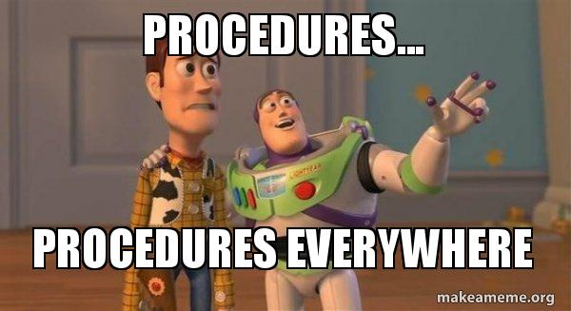
Procedures
anyone should be able to know exactly what you did from these numbered directions

Slide 7
TRials
You must have ten, 10, dieci, 10, diez, 10, dez, 10 TRIals.

Slide 8
Making data tables
Trials | Variable 1 | Variable 2 | Variable 3
1
2
3
4
5
6
7
8
9
10
Average
You will click on Insert and then click on the table icon and a table will be created
You can select how many rows and columns you will need – I would expect at least 12 rows

Slide 9
Your data table should include
Title so I know what the data means
The units of what is measured in METRIC units
What was tested (Independent Variable)
What was measured (Dependent Variable)
An average of all trials

Slide 10
Creating Graphs
You can create graphs by clicking on the graph icon
You can go to https://nces.ed.gov/nceskids/graphing/classic/
This site is super easy to use!

Slide 11
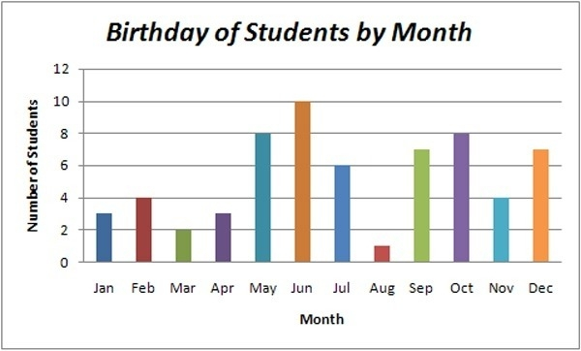
Title
Title and units on both the x and y axis
The testing variable on the X axis
The outcome variable on the Y axis
Y

Slide 12
Conclusion
Tell if the data does or does not support your hypothesis
Briefly explain what you did and if your procedure was successful
How you might improve you experiment for future study

Slide 13
bibliography
You need 5 sources
Your sources should be in mla format – use easybib.com
The isef website (https://student.societyforscience.org/intel-isef) can be a source. Where you found your project can be a source and if you used nces for graphing that can be a source.

Slide 14
Full information
You can find all this information in detail in your Teams notebook.

Slide 15
DUE DATES
Proposal Due November 01
Final Non-competition project due November 22

